Slide 1
Reverse Image Search
Guide: Dr. Puneet Goyal
Name: Aditya Tiwari(2016csb1029)

Slide 2
Objective
Given a image, Objective is to return similar images from our dataset

Slide 3
References
Research Paper Link
Online Codes used:
Code for Gabor Wavelet Vector
Support file for Gabor Wavelet Vector
Code for AutoCorrelogram Vector
Online DataSet used:
Link for online DataSet of images

Slide 4
Algorithm:
We can’t match query image with each image,that would require too large computation
So We first process each image in Data Set and get something useful and meaningful and store it.
We then get the same data for query image and compare it with DataSet and return the top-N images which are closest.

Slide 5
Algorithm-Continued
Preprocessing:We need to get something useful from the raw image
We create a vector of length 190 comprising different properties of the image which includes
Texture
Histogram
Color Pattern

Slide 6
Algorithm-Continued
The 190 length Vector comprises :
“We start by computing the color histogram for each image. In this case the HSV color space has been chosen and each H, S, V component is uniformly quantized into 8, 2 and 2 bins respectively. This produces a vector of 32 elements/values for each image.”
There are many models of HSV space,we shall use the cylinder one.Like RGB space,HSV also conveys information about image
Hue
Saturation
Value

Slide 7
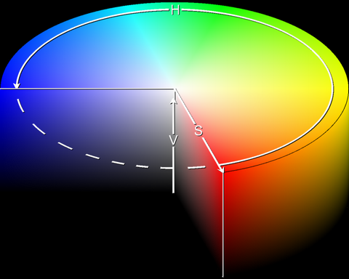
Meaning:
The Circle from top View is divided in 8 quadrants discrete levels.
The Height of the cylinder is in 2 levels.
And The Radius of Cylinder is in 2 levels
Calculations for a pixel value (r,g,b)
We can imagine RGB a vector
With r in red direction,g and b at 120 degree in Green and blue directions and calculate (h,s,v)
S will be the value of that vector
H will be the angle that vector makes with the Red
V is the maximum of r,g,b.
Then we can quantise them into discrete levels.
Then to collect information about them,we collect the % of frequency of H,S,V per level i.e Frequency/sum(HSV Frequencies)

Slide 8
Algorithm-Continued
The 190 length Vector comprises :
“The next step is to compute the color autocorrelogram for each image, where the image is quantized into 4×4×4 = 64 colors in the RGB space. This process produces a vector of 64 elements/values for each image.”
Correlogram: gives information about probability that for a given pixel, the probability that at d distance,pixel have same values as this.
AutoCorrelogram:Gives information about repetition of pixels,i.e texture information.
I have used a code for above purpose.

Slide 9
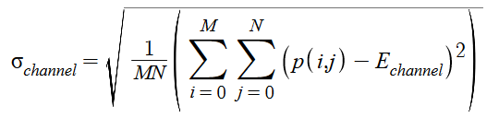
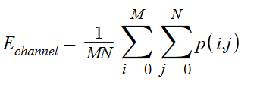
Algorithm-Continued
The 190 length Vector comprises :
“Next, we extract the first two moments (i.e. mean and standard deviation) for each R,G,B color channel. This gives us a vector of 6 elements/values.”
We calculate the mean and Standard deviation of each channel.

Slide 10
Algorithm-Continued
The 190 length Vector comprises :
“Moving forward, we compute the mean and standard deviation of the Gabor wavelet coefficients, which produces a vector of 48 elements/values. This computation requires applying the Gabor wavelet filters for each image spanning across four scales: [0.05, 0.1, 0.2, 0.4] and six orientations: “[θ0= 0, θn+1=θn+6/pi].We calculate the mean and Standard deviation of each channel.”
Meaning:
We first convert color images to gray images.
We apply Gabor Wavelet filter on image with different parameters-four frequency and Six orientations.Which yields 24 output matrix.Then we calculate mean and Standard Deviation of the matrix.
I have used an online available code for the above purpose.

Slide 11
Algorithm-Continued
The 190 length Vector comprises :
“Last but not least, we apply the wavelet transform to each image with a 3-level decomposition. In this case the mean and standard deviation of the transform coefficients is utilized to form the feature vector of 40 elements/values for each image.”
.
Meaning:
Wavelet transformation with decomposition provides information about edges and similar structures.We first convert image to gray level and resize to maintain uniformity .But 0-level decomposition doesn’t provides enough data about that. So we do it again on the output of first,that gives 1st level decomposition. We do it 4 times to get finally 3-level decomposition.

Slide 12
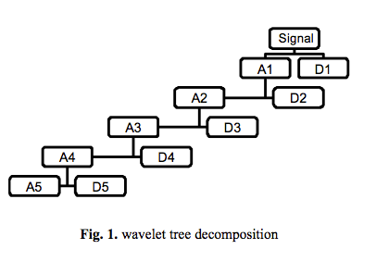
Algorithm-Continued
We use orthogonal/biorthogonal wavelet for decomposition and 3-level.
“A wavelet is a wave-like oscillation with an amplitude that begins at zero, increases, and then decreases back to zero.”
“A Biorthogonal wavelet is a wavelet where the associated wavelet transform is invertible but not necessarily orthogonal.”
“Using this wavelets a wavelet transformation is performed on the two dimensional image.”
Source wikipedia
We do above process 4 times.

Slide 13
Algorithm-Continued
Now that we have 190-vector of each image in data Set,we can query a given image.
For a given Query image,we calculate the above 190-vector and we compare it with the dataSet and return the top-N images with most similarity.
There are multiple methods of comparison but we use:
Consider Vectors as Euclidean Vectors and compute the Euclidean distance as a measure of similarity,smaller the better.This is faster and requires lesser computation.

Slide 14
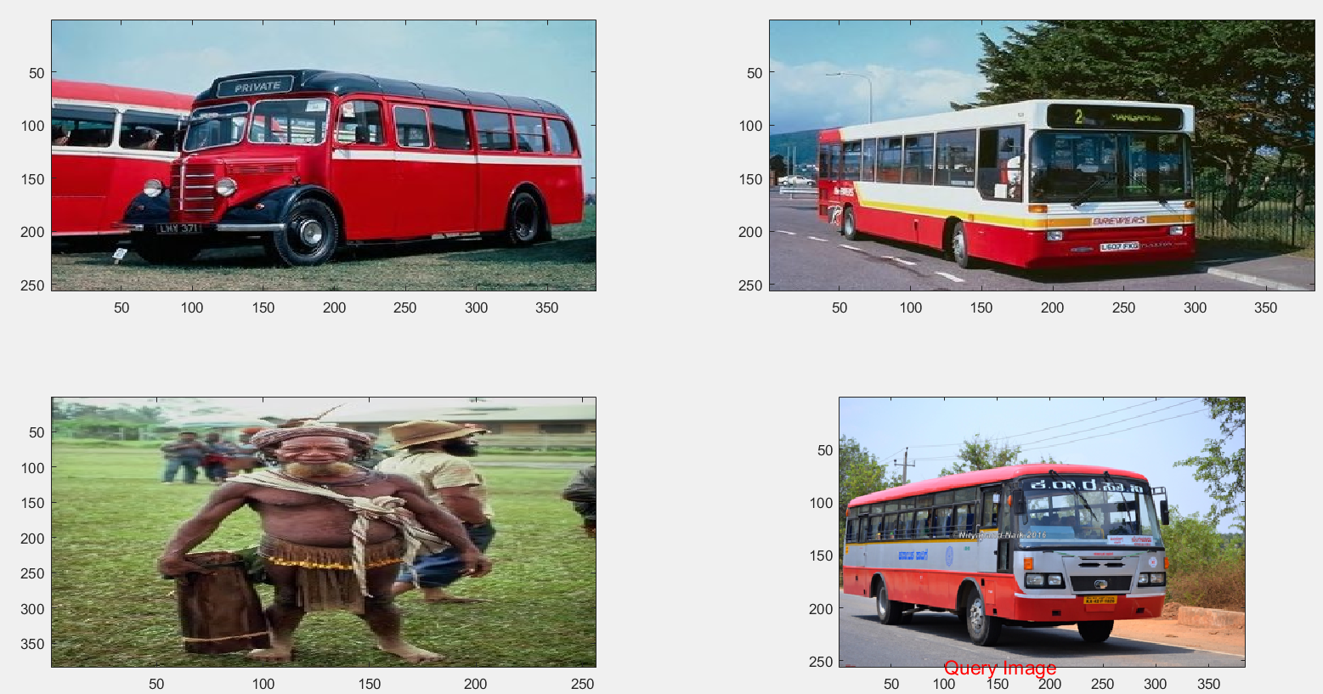
Results

Slide 15
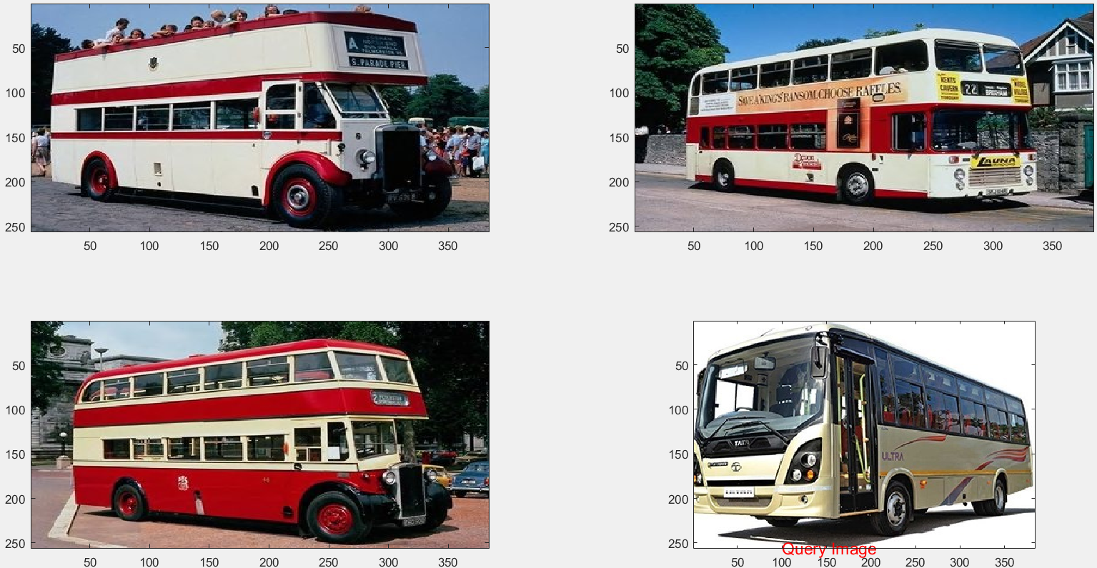
Results

Slide 16
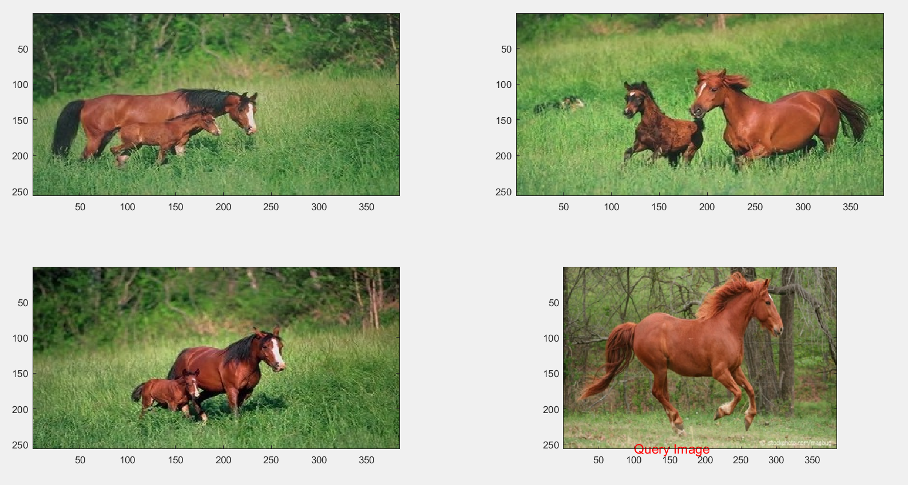
Results

Slide 17
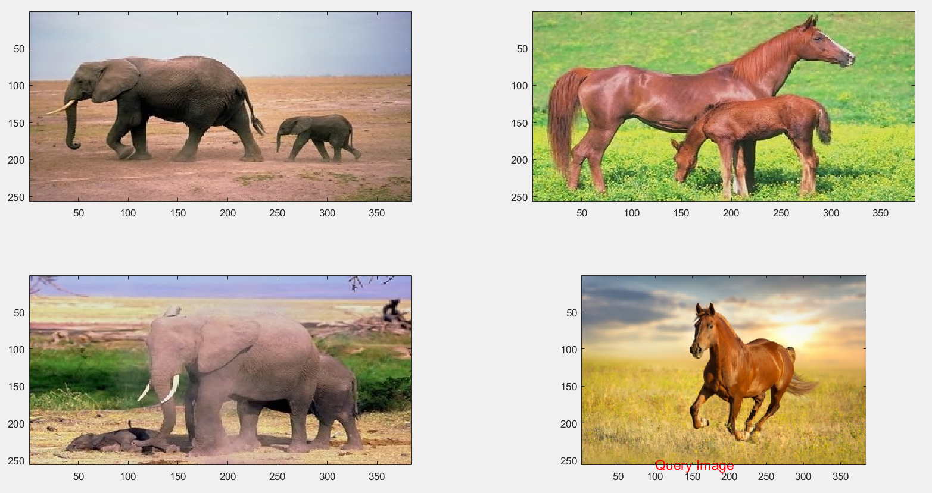
Results

Slide 18
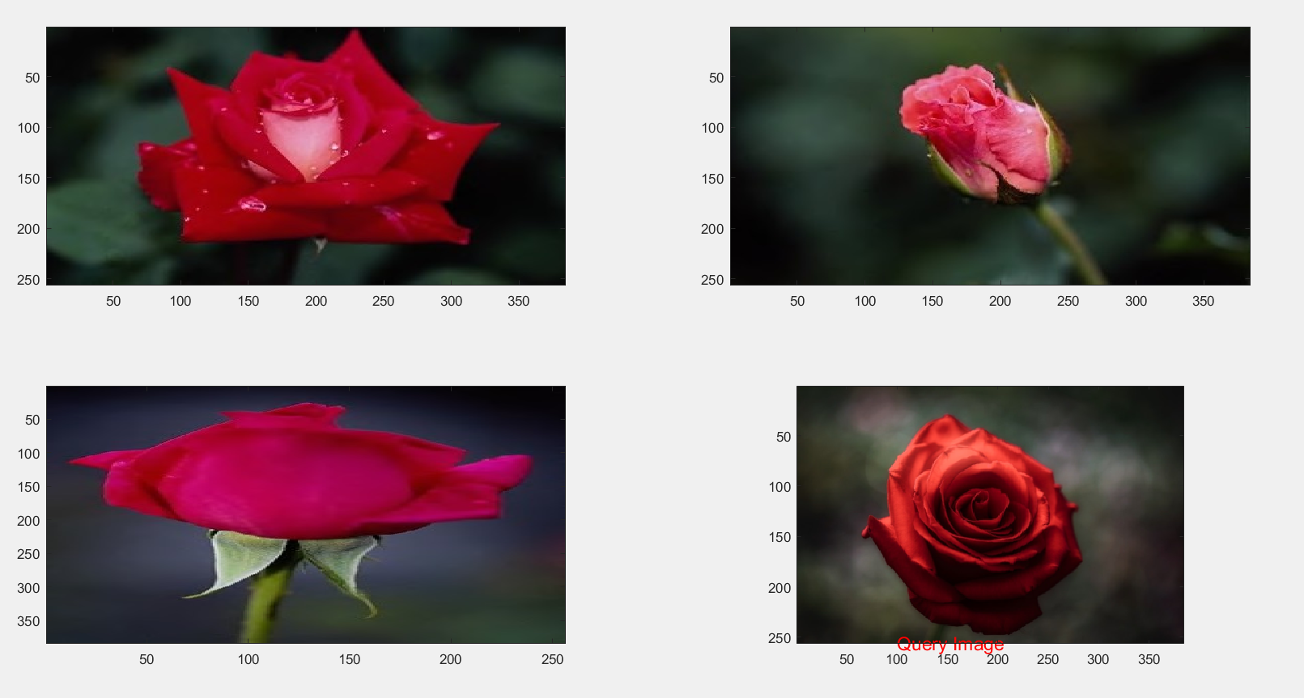
Results

Slide 19
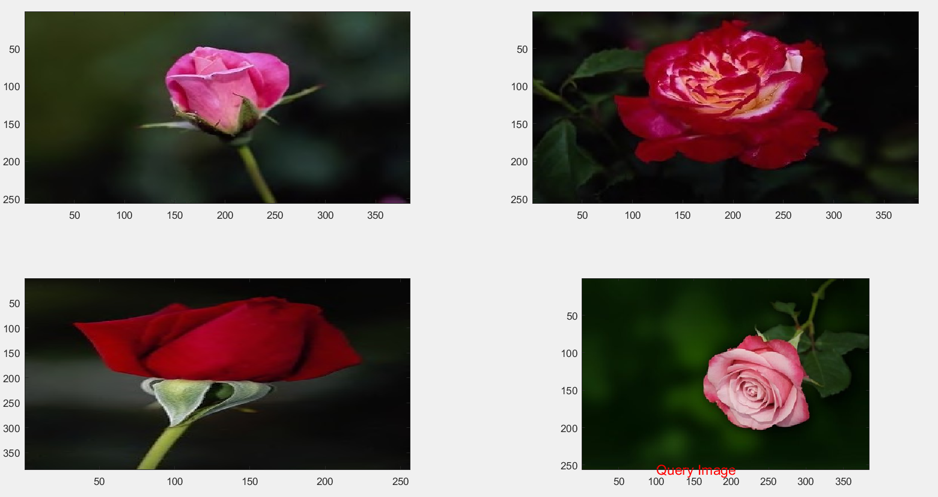
Results

Slide 20
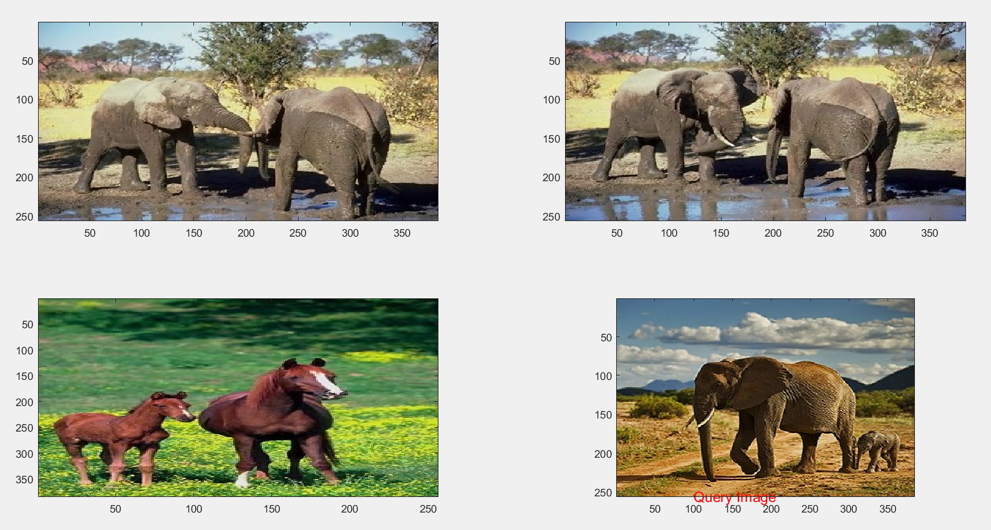
Results

Slide 21
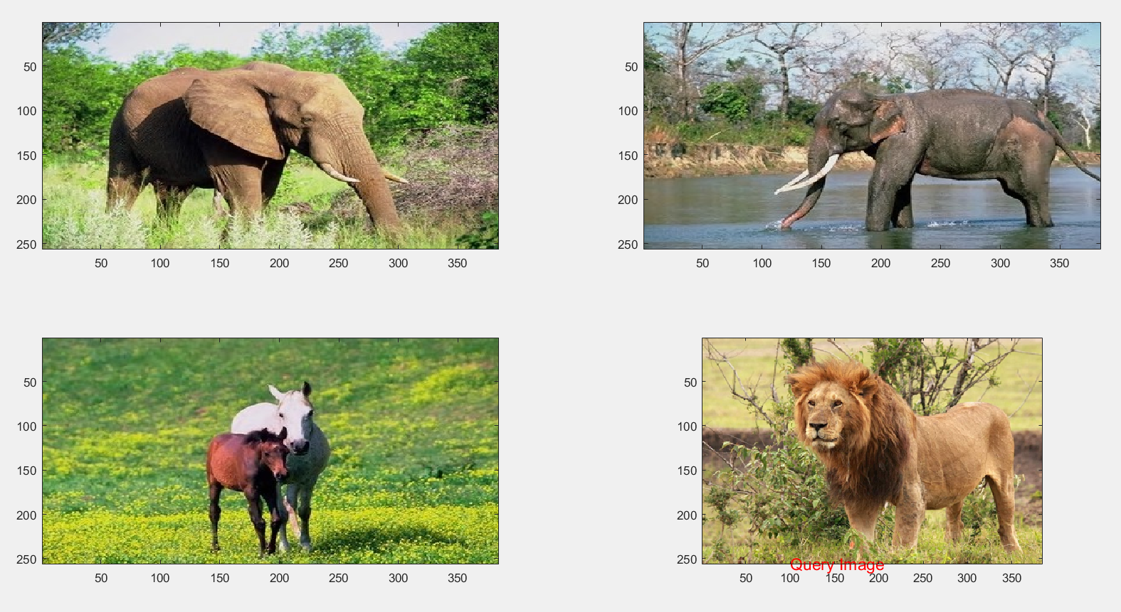
Results
There was no photo of lion in the dataset

Slide 22
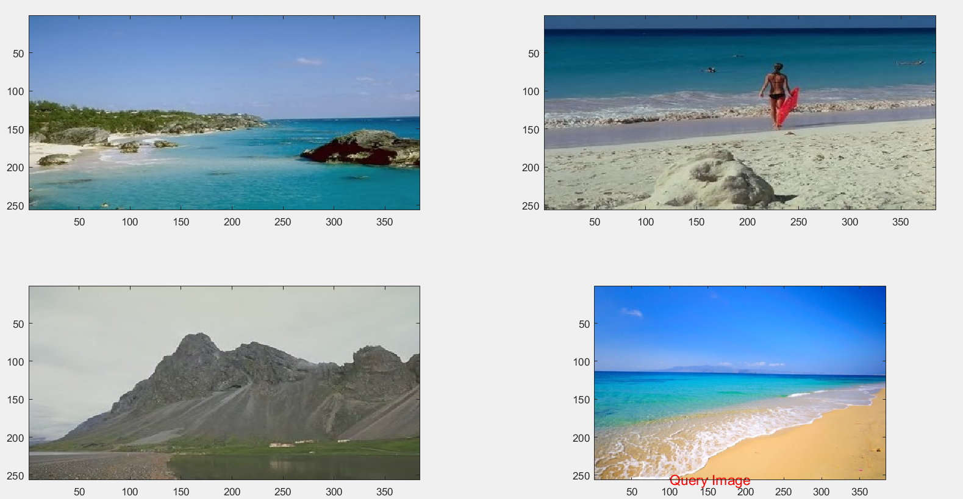
Results

Slide 23
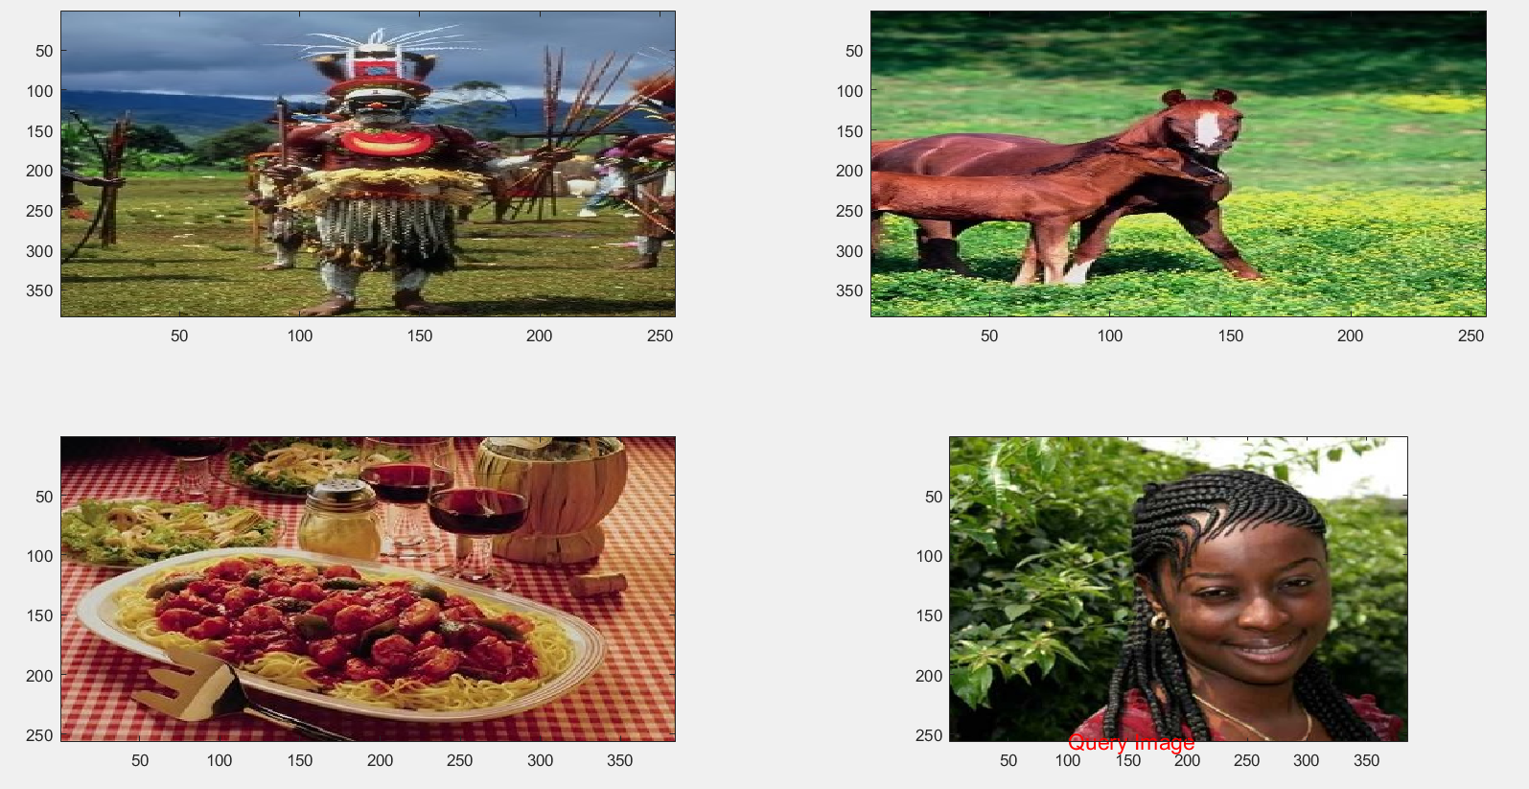
Results-Inconsistent Output

Slide 24
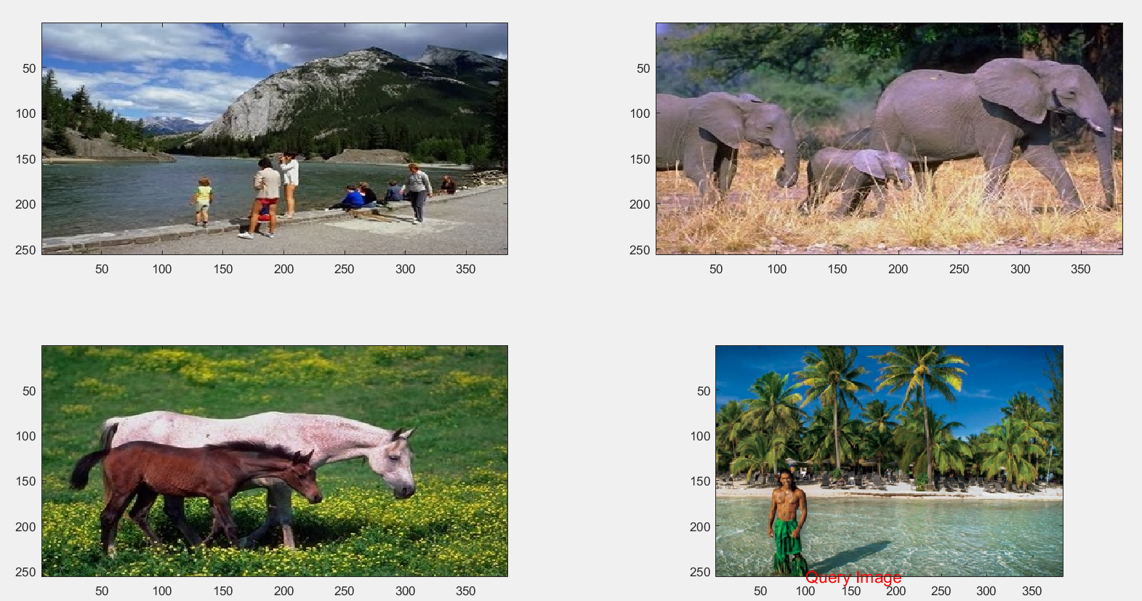
Results-Inconsistent Output

Slide 25
Thank you
Scope of Improvement:
For matching vectors, we could provide weights to different properties like decomposition transformation could be considered as edges i.e shapes and provide say more weight compared to texture which is given by autocorrelogram.
We could increase out vector size and take in more information about image using more methods.
If we could associate a term with each image it would be much easier to search using terms and improve accuracy.Like google does.

